Slide 1
England Hockey –skills
Video Taken from England hockey coaching sessions

Slide 2
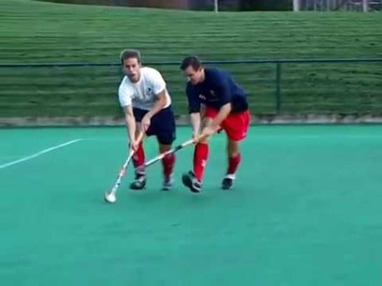
Defending
skills

Slide 3
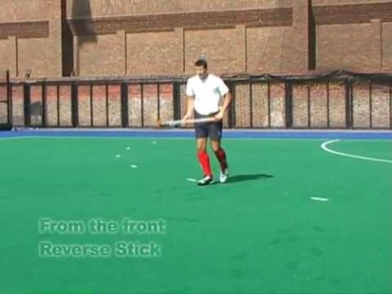
Receiving
skills

Slide 4
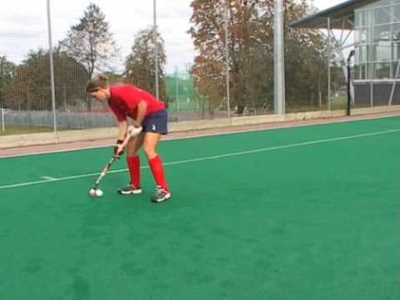
Passing
Skills

Slide 5
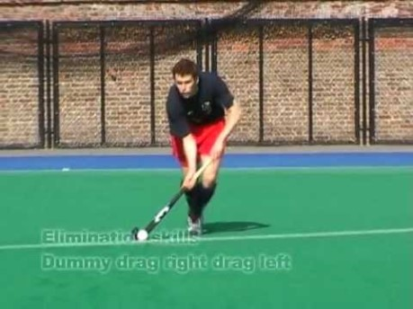
Elimination
skills

Slide 6
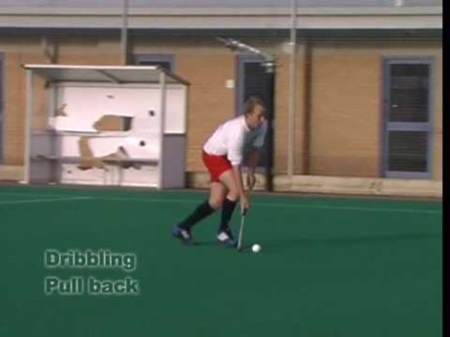
Dribbling
skills

Slide 7
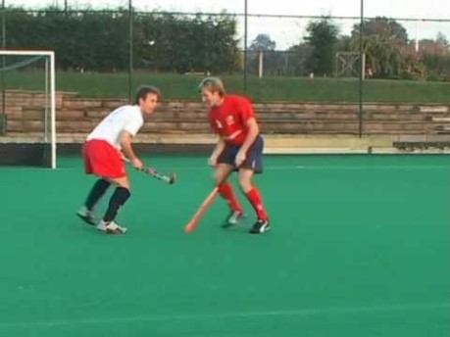
Making
Space

Slide 8
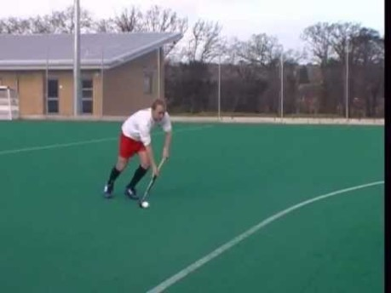
Goal
scoring

