Slide 1
Basic Skills
There are vast amounts of information available on hockey skills. We have taken a sample and put them into this PowerPoint, links from YouTube videos on the basic skills of hockey. They are taken from various sources, and all show a little different aspect to each skill. This PowerPoint is aimed at new coaches / players to the sport

Slide 2
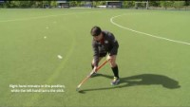
Core
Base Skills

Slide 3
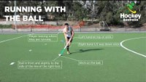
Open
Dribble

Slide 4
Hitting

Slide 5
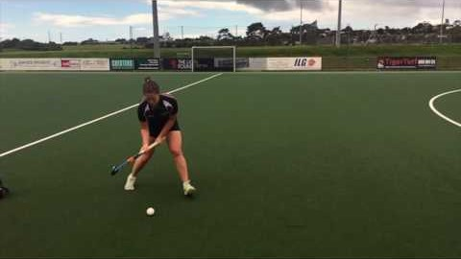
Stationary
Hit

Slide 6
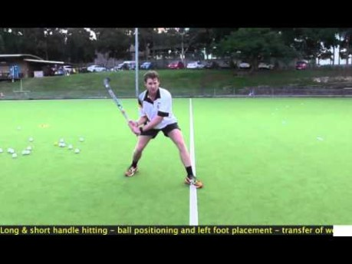
Stationary
Hit

Slide 7
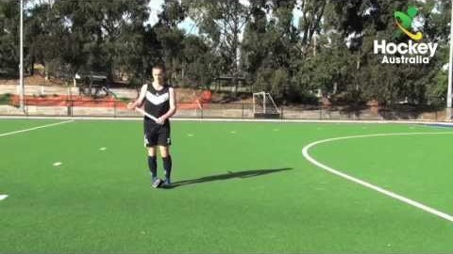
Stationary
Hit

Slide 8
Pushing

Slide 9
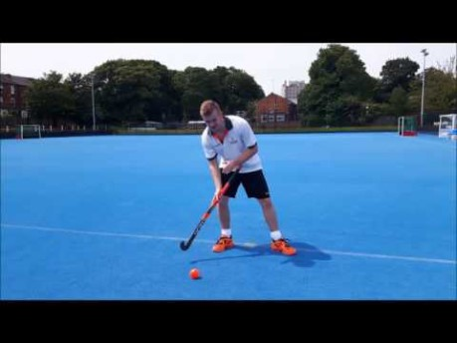
Stationary
Push

Slide 10
Stationary
Push

Slide 11
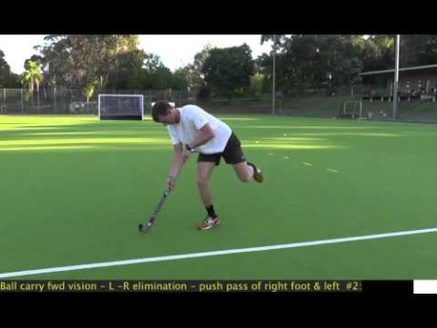
Moving Push

Slide 12
Left to Right Dodge

Slide 13
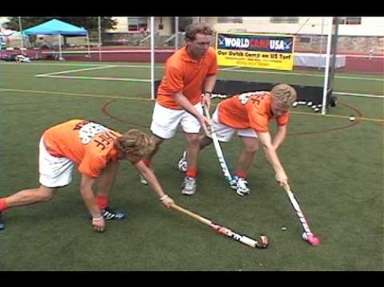
Left to Right
dodge

Slide 14
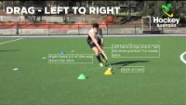
Left to
Right Drag

Slide 15
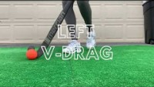
V-Drag

Slide 16
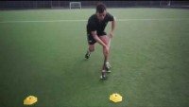
Left to
Right Drag

Slide 17
Umpiring

Slide 18
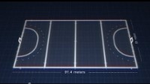

Slide 19
